Slide 1
From PLATO to OpenAI:
Developments in Cyberspace
Kaido Kikkas
SPEAIT, Autumn 2023
2023 Kaido Kikkas. This document is dual-licensed under the GNU Free Documentation License (v l.2 or newer) and the Creative Commons Attribution-ShareAlike (BY-SA) 3.0 Estonia or newer license

Slide 2
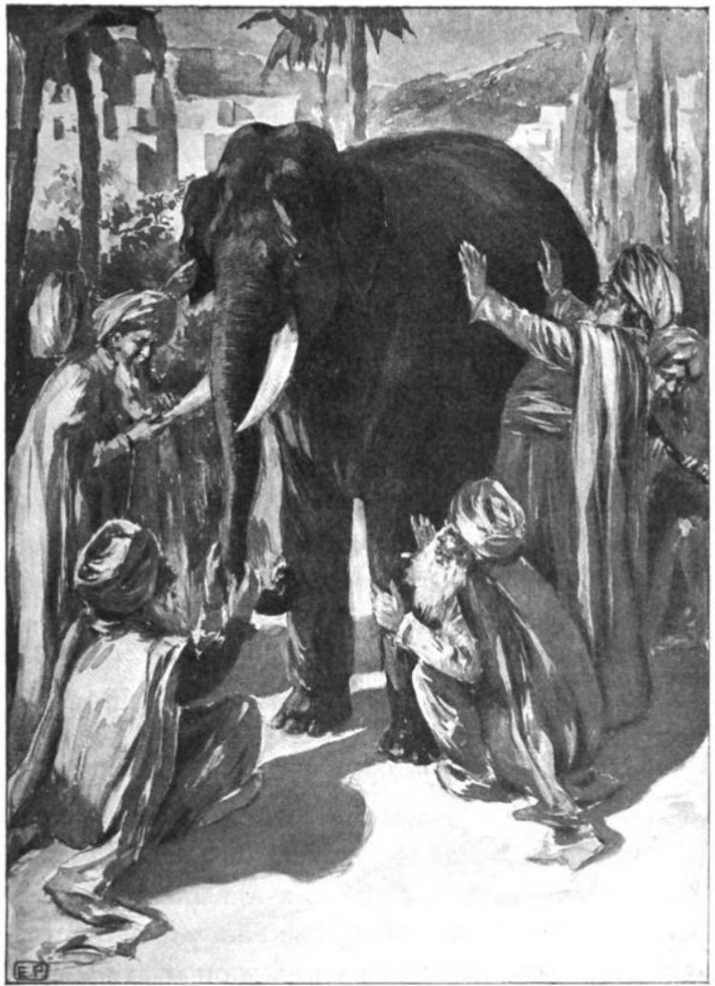
For starters: touching the elephant,
- or, everyone’s got an opinion
“A quite recently invented nice place to read news, write to friends and chat”
“A toy for computer nerds”
“A lot of info - and, of course, ChatGPT”
“Warez is cool!”
“Cyber, the 5th dimension of warfare”
“Unlimited advertising!”
“Playground of perverts and other weirdos”
“The mystical cyberspace”
Illustrations come from Wikimedia Commons, if not noted otherwise

Slide 3
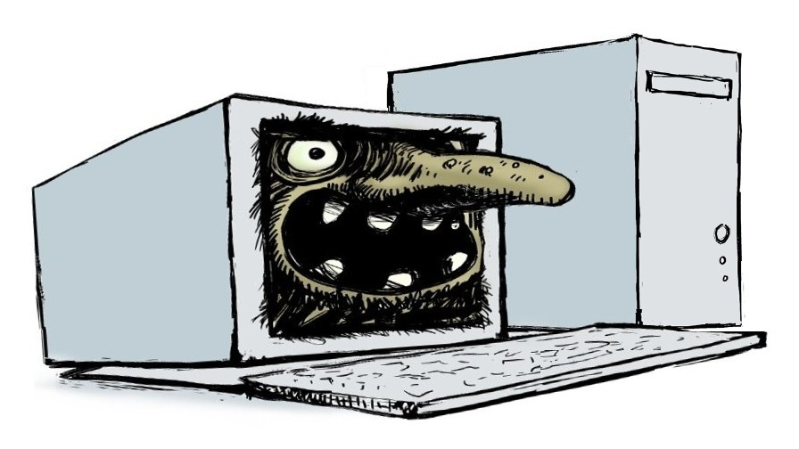
You’ll get what you’re looking for
Plenty of useful information <=> loads of bullshit
Many nice people <=> a host of dorks and idiots
An interaction aid <=> a source of 'Ooops..!'
A place to get help <=> a source of despair
A media channel <=> yellow news, deepfakes and hate speech
Literature and art <=> a toilet wall
('F… you, too!')
Faeryland <=> cyberjungle

Slide 4
Two small parables
Internet is a knife – a surgeon can save lives, a bandit can kill someone
Internet is an amplifier – for human relations, mass media, wisdom, stupidity...

Slide 5
Main services
The Web (WWW)
E-mail
File transfer (FTP, various P2P solutions)
Virtual terminal / remote access (Telnet, SSH)
Real-time interaction (IRC, talkers, MUD, IM, VoIP, Zoom etc)
Derivatives and combinations of the above

Slide 6
When did it all start?
Again, opinions differ. Some possible starting points include
  The Atlantic Cable 1858/1866 (the first connection)
  Nevil Maskelyne vs Guglielmo Marconi: the 1903 radio hack
  Hackers: the U.S. radio amateurs of early 20th c.; Radio Act 1927
  The War of the Worlds media panic 1938
  As We May Think by Vannevar Bush 1945 (Memex and microfilms)
  Cybernetics by Norbert Wiener 1948 (tech + management)
  The AI Conference at Dartmouth 1956 (McCarthy and Minsky; the first suggestion of exponential growth of tech, aka Moore’s Law)
  Sputnik 1...

Slide 7
Competing narratives
Was the Internet born
  …of the need to protect the U.S. against the imminent Soviet nuclear attack? (still the prevailing opinion)
  ...as a manifestation of the hippie-influenced techno-culture (classic hackerdom in MIT and Stanford? (Hackers by Steven Levy, and several others)
  ...as a surveillance tool from day one (another question is how much of this was actually necessary; e.g. see the Surveillance Valley: The Secret Military History of the Internet by Yasha Levine, 2018)

Slide 8
“OMG! The Russians are in space!”
Someone said: “The Russians put up Sputnik yesterday, and it goes around the world saying beep-beep-beep. Then, when it gets to the U.S., it says ha-ha-ha.”
NY Times on Oct 4, 1957: “A shocker like Pearl Harbor, waking America up and making it buckle down.”
The National Defence Education Act 1958 – 5 bln $ => 13 bln
The Advanced Research Projects Agency (ARPA) and their 'nuclear shield' programme – one of the goals was to create a control network capable to keep working 'half dead' (the assumption was that the Russians will shoot first)

Slide 9
Early research
1960 – Man-Computer Symbiosis by J.C.R. Licklider
1961 – a theoretical foundation for a new type of network laid by Leonard Kleinrock at MIT
1962 – Augmenting Human Intellect: A Conceptual Framework by Douglas Engelbart
1964 – the first practical specification by Paul Baran. The central idea was to divide the whole traffic into packages that find their way over the network independently
1965 – Welsh computer scientist Donald Davies proposed the same solution independently of Baran (at the UK National Physical Laboratory)

Slide 10
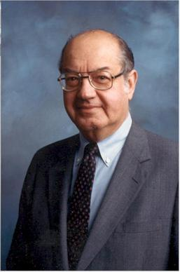
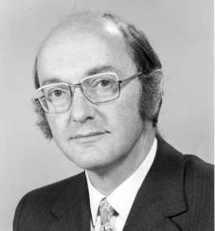
The fathers of the Internet (in a way)
Paul Baran (US)
1926-2011
Donald Davies (UK)
1924-2000

Slide 11
Summer of ‘69 (thanks, Bryan)
The most popular suggestion for the birth of Internet
4 nodes: Santa Barbara, UCLA, Stanford, Utah
The first login (Oct 29, 1969; Charles S. Kline from UCLA to Stanford) crashed at 'g'… Incidentally, the first word transmitted online was ‘lo’ (as in ‘lo and behold’)
The spiritual roots of Internet - academy + counterculture
(so that's why there are so few normal people online...)

Slide 12
The tech Babel
For a while, no common 'language' existed
1970 – the first attempt in NCP (Network Control Program), the first layered approach and development of the Open Systems Interconnection (OSI) model
1974 – Transmission Control Program
1978 – Transmission Control Protocol / Internet Protocol (TCP/IP), developed by Robert Kahn and Vinton (Vint) Cerf

Slide 13
First e-mails, plus an online shrink
1971 – ARPAnet spanned the whole 23 computers
A MIT engineer named Ray Tomlinson sent the first text message between computers. His application to ARPAnet for a new protocol was approved and e-mail was born. He also borrowed the @-sign from teletype
1972 – first real-time long-distance text chat – a 'patient' in Stanford and a 'psychiatrist' in Massachusetts. To top it off, both were actually what we call bots today (PARRY vs ELIZA). While ELIZA was a lighthearted creation of engineers, PARRY the paranoid schizophrenic was actually the brainchild of psychiatrist Kenneth Colby

Slide 14
Expansion
1970 – AlohaNet on Hawaii, a wireless connection
1973 – expansion to the UK and Norway, the term 'Internet' adopted. First specification of FTP. Bob Metcafe invented Ethernet
UIUC PLATO Notes – a pioneer of many things (first online community, e-learning, plasma monitors… but also viruses; see the Friendly Orange Glow by Brian Dear 2017)
1975 – first mailing lists. Queen Elizabeth became the first head of state to send e-mail. First version of the Jargon File

Slide 15
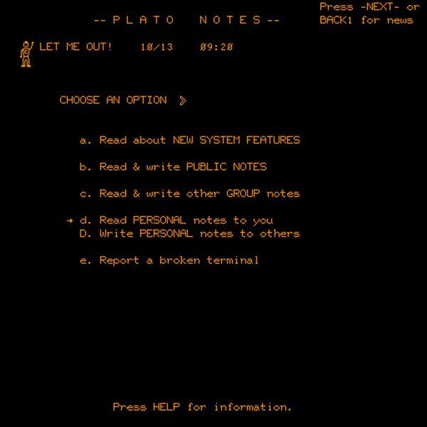
A screenshot of the UIUC PLATO

Slide 16
“Stop the damn world, I wanna get off!”
The Vietnam War (1965-75) and Nixon's Watergate (1972-74) – many people in the U.S. got a rude awakening
Among other things, emergence of crackers, phreakers and other similar creatures - “the government does not deserve respect anymore, it deserves a finger!”
Primitive viruses, first ‘electronic’ bank heist (~1.5 mln USD by Roswell Steffen; later contested by some authors), Steve Wozniak trolled the Pope (calling as Henry Kissinger)

Slide 17
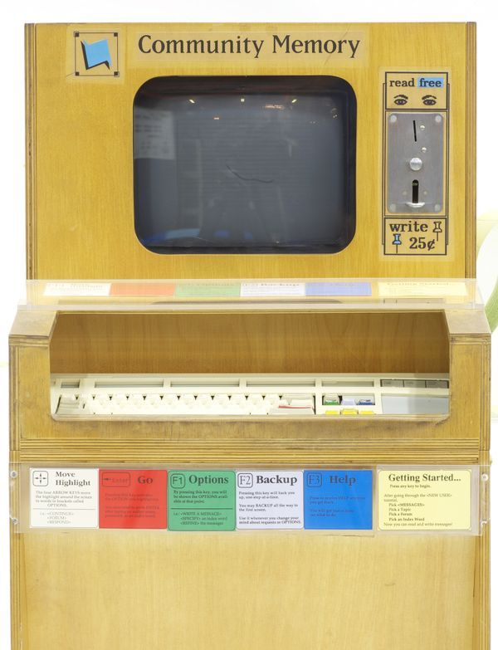
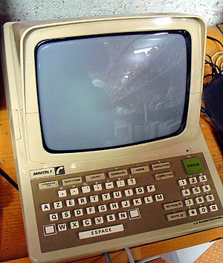
70s
1973-75: Community Memory at
UC Berkeley
1975 – Minitel (France) and
CompuServe (US)
1978 – first BBS opened in Chicago
1979 – first MUD at the University of Essex, UK
A controversial idea (the author is disputed, could be Scott Fahlman or Kevin McKenzie) to add characters denoting emotions to texts – after a while, smileys/emoticons started to spread (What is that? >8-[ ]} )

Slide 18
80s: Internet gets ready (for a short while)
1982 – TCP/IP adopted as the universal base of Internet
1983 – FidoNet (note: still alive as retrocomputing – somewhat even grown since 2015)
1983 – first nameserver standard (NIC)
1984 – first DNS
1985-1990 - a period of stability: main services were E-mail, Telnet, FTP and Usenet, IRC was added in 1988

Slide 19
Birth of the Web
1989 – CERN (European Organization for Nuclear Research) connected to Internet
1990-91 – a British independent contractor named Timothy Berners-Lee proposed a novel method for non-linear (hypertext) documents (the ‘Web page No 1’ is still online at https://info.cern.ch/hypertext/WWW/TheProject.html) The system was published via CERN FTP site and spread rapidly
Note: Berners-Lee refused to use any restrictive measures for his invention

Slide 20
Prerequisites for the Web explosion
The Protocol: HTTP by Sir Timothy
The new operating system called Linux, also released in 1991 (and a bit later, also the Apache web server software)
MS Windows, the first ubiquitous GUI for PC-s
NCSA Mosaic and later Netscape, the first web browsers

Slide 21
Right time, right place
Like at other important points in history, some people made a lot of money:
Marc Andreessen – left NCSA, founded Netscape and ruled the web for some years
Brian Pinkerton – built Webcrawler, the first web robot, as a part of his thesis at the University of Washington
Two Stanford students named David Filo and Jerry Yang piled up their web links and built a large 'Web catalogue', later known as Yahoo
A bit later, two more Stanford (doctoral) students – Larry Page and Sergey Brin – made it really big

Slide 22
90s
1993-94 – governing organizations created (InterNIC and W3C)
1995 – birth of LAMP and Java
1995-2000 – the censorship wars in the U.S. (CDA, COPA, CIPA)
1996 – A Declaration of the Independence of Cyberspace by John Perry Barlow
1998 – ICANN takes over from InterNIC, the current domain system is introduced

Slide 23
The (first) browser war
1994-95 – Microsoft ignored Internet and aimed to build their own Microsoft Network
1996 – MS woke up and attempted to 'divide the market' with Netscape. Refusal provoked an all-out offensive
Spyglass => IE
1997 – MS won the first war. Netscape open-sourced their newest prototype
The war goes on till today – Mozilla/Firefox and others; recently another giant (Google) has largely taken the market over

Slide 24
Why did IE prevail?
A number of different reasons, including
  In a quite unprecedented move for early Microsoft, IE was offered for free (in monetary sense) – Netscape was only gratis for private persons and NGOs, companies had to pay
  Integration with Windows (“It came with the computer!”)
  A lot of shady moves typical for the company (e.g. the Compaq blackmail with Windows licenses)
IE won the (first) war – and stagnated on version 6 for the next three years (almost no development)

Slide 25
Messengers
Forefathers: Unix Talk and MUDs/talkers
1996 – ICQ (I Seek You – meant for finding game partners)
1997 – AOL Messenger, later developing into Gaim/Pidgin
1999 – Microsoft Messenger (aka MSN Messenger and Windows Live Messenger)
2000 – Jabber and multi-protocol clients (e.g. Trillian)
Later, convergence with VoIP apps (Skype), microblogging (Twitter/X), social networks (FB Messenger), mobile platforms (Signal, Telegram), video chat systems (Zoom, Teams, Jitsi)...

Slide 26
“Web for common people”
Back then, proper webmasters had to know HTML – it was considered too esoteric for ‘Uncle Bob’
First sites for ‘normal people’: GeoCities, Angelfire, Tripod
  On the one hand, the web pages were clumsy, ugly hacks
  On the other hand, it was the first real ‘window to the Web’ for commoners – and as such a forerunner of social media
The tendency goes on – for a while, Wix.com filled the niche, today even WordPress inclines towards it

Slide 27
Remember the history
On early Internet, if stuff disappeared, it was gone for good
In May 1996, Brewster Kahle founded the Internet Archive (archive.org)
Especially important is the Wayback Machine for the Web
Data checked on Sept 15, 2023:
  735 billion web pages
  41 million books and texts
  14.7 million audio recordings (including 240,000 live concerts)
  8.4 million videos (including 2.4 million Television News programs)
  4.4 million images
  890,000 software programs

Slide 28
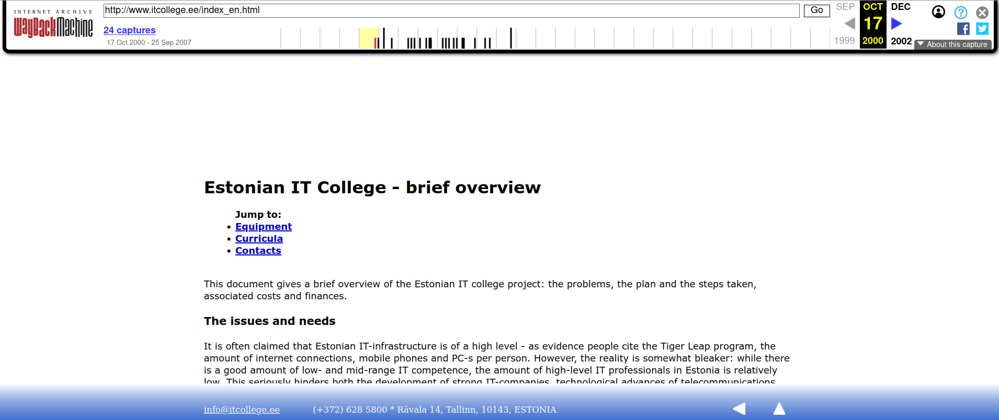
An example: the earliest snapshot of the IT College website (in English) from 2000
https://web.archive.org/web/20001017174045/http://www.itcollege.ee/index_en.html

Slide 29
Millennium
Commercialization and dotcom boom
Multimedia
FLOSS emerged as a serious alternative (also on desktop)
New domain names (.name, .biz, .info)
Internet as a venue for games and relationships
Legal nitpicking and cyberdung

Slide 30
Social software and social media
Networked services and applications that actively involve the user community
Wikipedia 2001, Flickr 2004, YouTube 2005…
Blog boom => web services (Blogger.com, WordPress.com) and standalone software (Movable Type, TextPattern, WordPress)
Increasing use in education and business
Microblogging (Twitter, Jaiku, identi.ca)
Social networks
Darker side: 4chan (2003)

Slide 31
Web-based social networks
Main players
  2002 Friendster (and Rate.ee in Estonia)
  2003 MySpace and LinkedIn
  2004 Facebook and Orkut
  2005 YouTube and Reddit
  2006 Twitter and VK
  2009 WhatsApp, Pinterest and Sina Weibo
  2010 Instagram and Diaspora
  2011 Snapchat, Google Plus and Twitch.tv
  2012 Tinder
  2015 Discord
  2016 TikTok
Notable rise-and-falls:
  Orkut
  Google Plus

Slide 32
“Because we can”
In times of old, nobody could just write an encyclopedia, add new stories to the Lord of the Rings or be a hotshot reporter at an international crisis site
Today, we have (respectively) Wikipedia, Fanfiction.net/AO3 and Twitter/Flickr/Facebook/Snapchat/…
Read more on the topic: The Wealth of Networks by Yochai Benkler (see benkler.org)

Slide 33
Internet of Things
The idea of interacting devices was already proposed in the 80s (Carnegie-Mellon had an online Coke machine back in 1982).
Real spread since about 2008-2009
Main categories:
  Consumers (home automation, assistive solutions...)
  Organizations (medical systems, public transport…)
  Production (industry, agriculture...)
  Infrastructure (smart houses/cities, environment control…)
Internet of Bad Things…?

Slide 34
Three layers
… of the Web (often confused):
  Surface web – ‘ordinary’ Web, available for indexing (basically, “what Google sees”)
  Deep web – the parts of the Web with restricted access (“what Google does not see” – online banks, many e-learning environments, essentially everything with authentication)
  Dark web – overlay networks (darknets) that use protocols like Tor or I2E, not accessible with ordinary means (Brave browser probably has the closest to the wider public, followed by the Tor browser suite)

Slide 35
Dark web
2004 – a new type of communication channel tested by a US Navy research laboratory (together with EFF), the aim being to create something that dissidents in the ‘bad countries’ could use
2006 – Tor Project
2009 – the term ‘Dark Web’ appears
2011-2013 – Ross Ulbricht ran the Silk Road (2.0 operated for a shorter time in 2013-2014)
A bit off the radar for now – dangerous for possible AI-related developments going on ‘somewhere in the dark’

Slide 36
COVID-19 and life from distance
2019/20 – the pandemic effectively locked down many societies, those who already had the ‘distance life’ experience took it lighter
Forced e-learning and telework: Zoom, MS Teams, Jitsi Meet etc
In Estonia, a number of centrally-offered tools: jitsi.eesti.ee (Jitsi Meet), vestlus.eesti.ee (RocketChat) and sahver.eesti.ee (NextCloud)
Somewhat boosted the development of cross-platform solution (an example: MS Teams moving from locally installed clients to a web-based, cross-platform solution)

Slide 37
“Let the machine think for us!”
2015 – OpenAI founded as NGO, turning into a company in 2018/19
2020 – GPT-3, 2021 – DALL-E, 2022 – ChatGPT
Quite a confusion and panic in several fields, still going on (including education and research)
The knife and amplifier metaphor (quoted earlier) applies here as well
Dangers do exist – and are worse due to improbability of global agreement (some countries do not care)

Slide 38
Ignorance can kill
A serious problem of the recent years
Cheap PC + ubiquitous Internet + insecure software + stupid user = LOADS OF CRAP
Malware, credit card fraud, phishing, social engineering, DDOS…
No clear-cut solution. Mandatory 'driving license'? Allow remote administration by software vendors (newer Windowses seem to go that way)? Outlaw Windows?
A major problem: lack of motivation (in several ways)

Slide 39
“What about the future? You can shove it…” (Meat Loaf)
Even more multimedia
Semantic Web and Big Data
More fun (but no work?)
Digital Enclosure
Network of humans… or machines (IoT, AI, bots…)?
More controlled and commercial? Or back to the roots? Or split the thing in half?
Death by dung?
We'll see...

Slide 40
Additional reading
Moschovitis C. et al. History of the Internet
Living Internet, http://www.livinginternet.com/i/ii.htm
Hobbes' Internet Timeline, http://www.zakon.org/robert/internet/timeline/
History of the Internet, http://www.nic.funet.fi/index/FUNET/history/internet/en/etusivu-en.html
ISOC. History of the Internet, http://www.internetsociety.org//internet/internet-51/history-internet

Slide 41
That’s it for today :)

